Slide 1
Sequencing

Slide 2

What to do:
Log into your Google Drive account
Make a copy of these slides and save to your own Google Drive
File → Make a Copy and save with appropriate name
Watch the video for each program
Move scrambled blocks on left side of the slide to the right side of the slide under block
Use the video and comment to figure out the correct ordering and placement of instructions

Slide 3
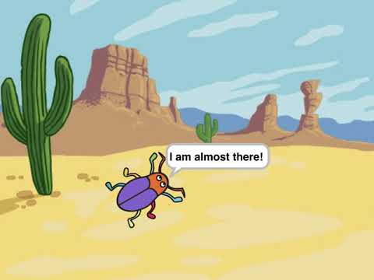
Program #1:
Beetle goes to cactus

Slide 4







Slide 5
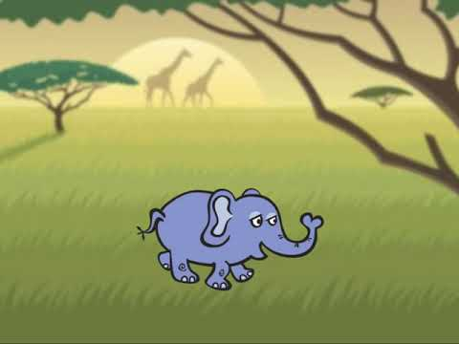


Program #2:
Elephant sneezes

Slide 6
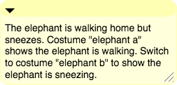





Slide 7
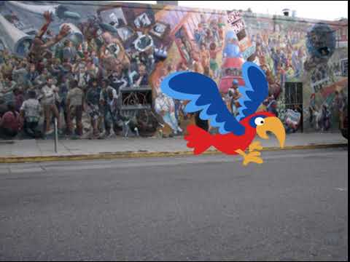

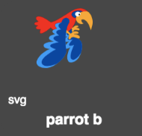
Program #3:
Parrot in Berkeley

Slide 8






Slide 9
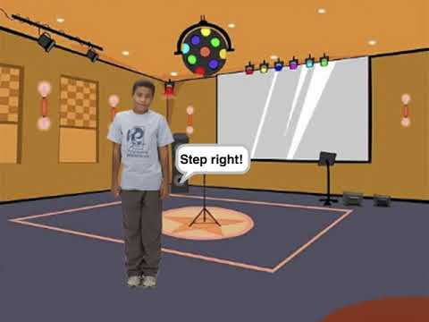
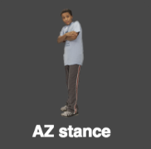


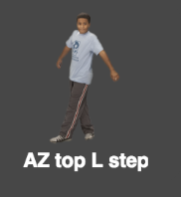
Program #4:
AZ’s dance moves

Slide 10
